Slide 1
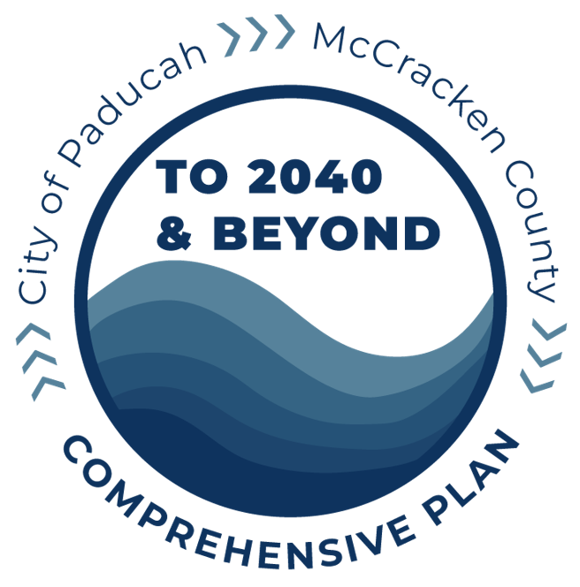
Joint Public Hearing: City and County
Planning Commissions
November 19, 2024
GARY MITCHELL
President and Project Manager

Slide 2
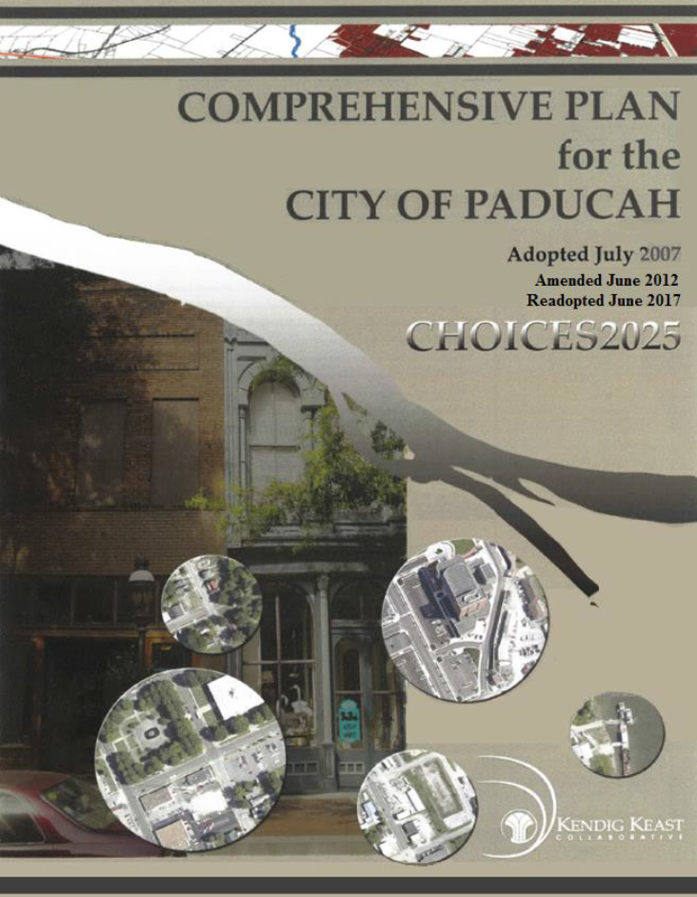
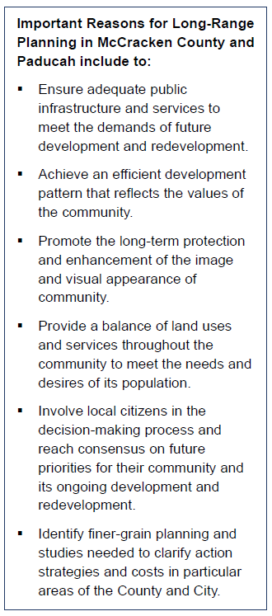
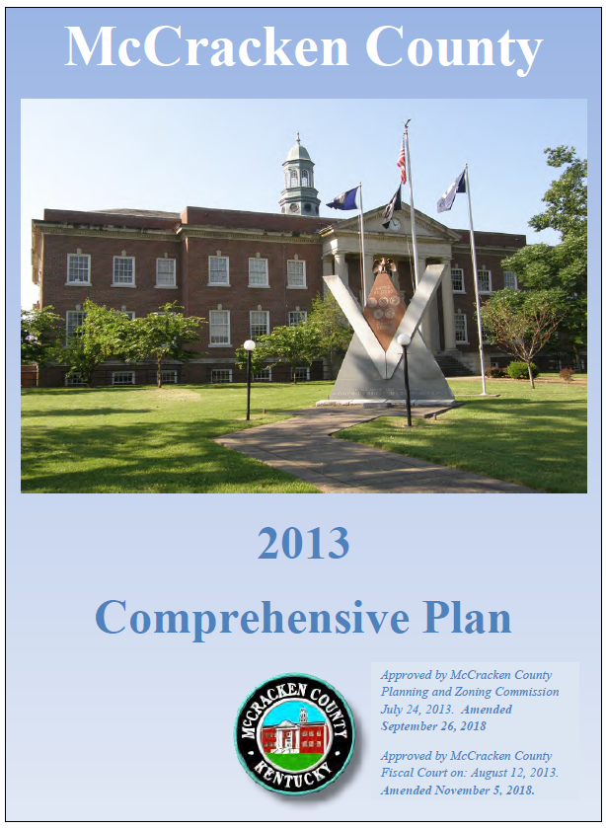
5-Year Updates Required by State Law

Slide 3
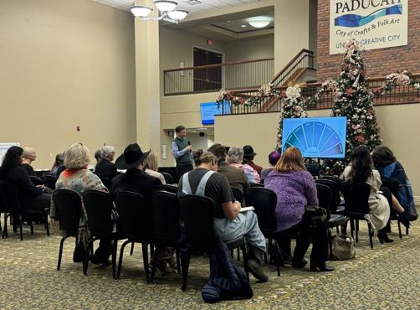
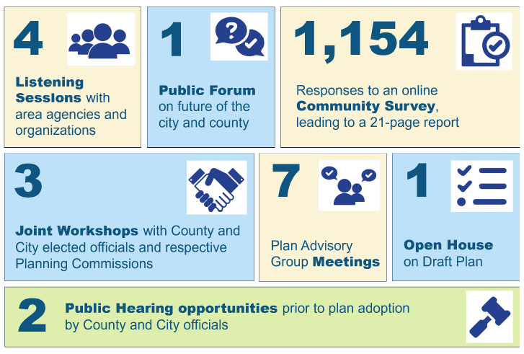
Community and Leadership Engagement

Slide 4
6 Comprehensive Plan Themes
Retain / add population
Wider range of job options
More and varied housing options
Safe community
Improved infrastructure (stormwater)
Neighborhood / corridor revitalization
Economic advantage from location + transportation
Build on arts/crafts/culture and tourism success

Slide 6
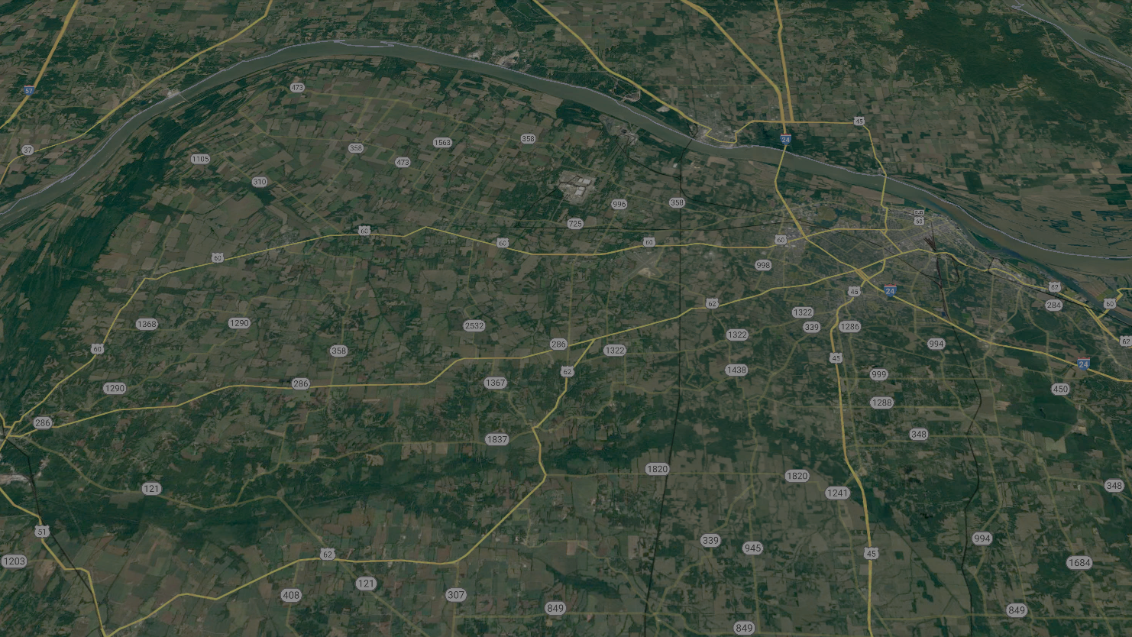
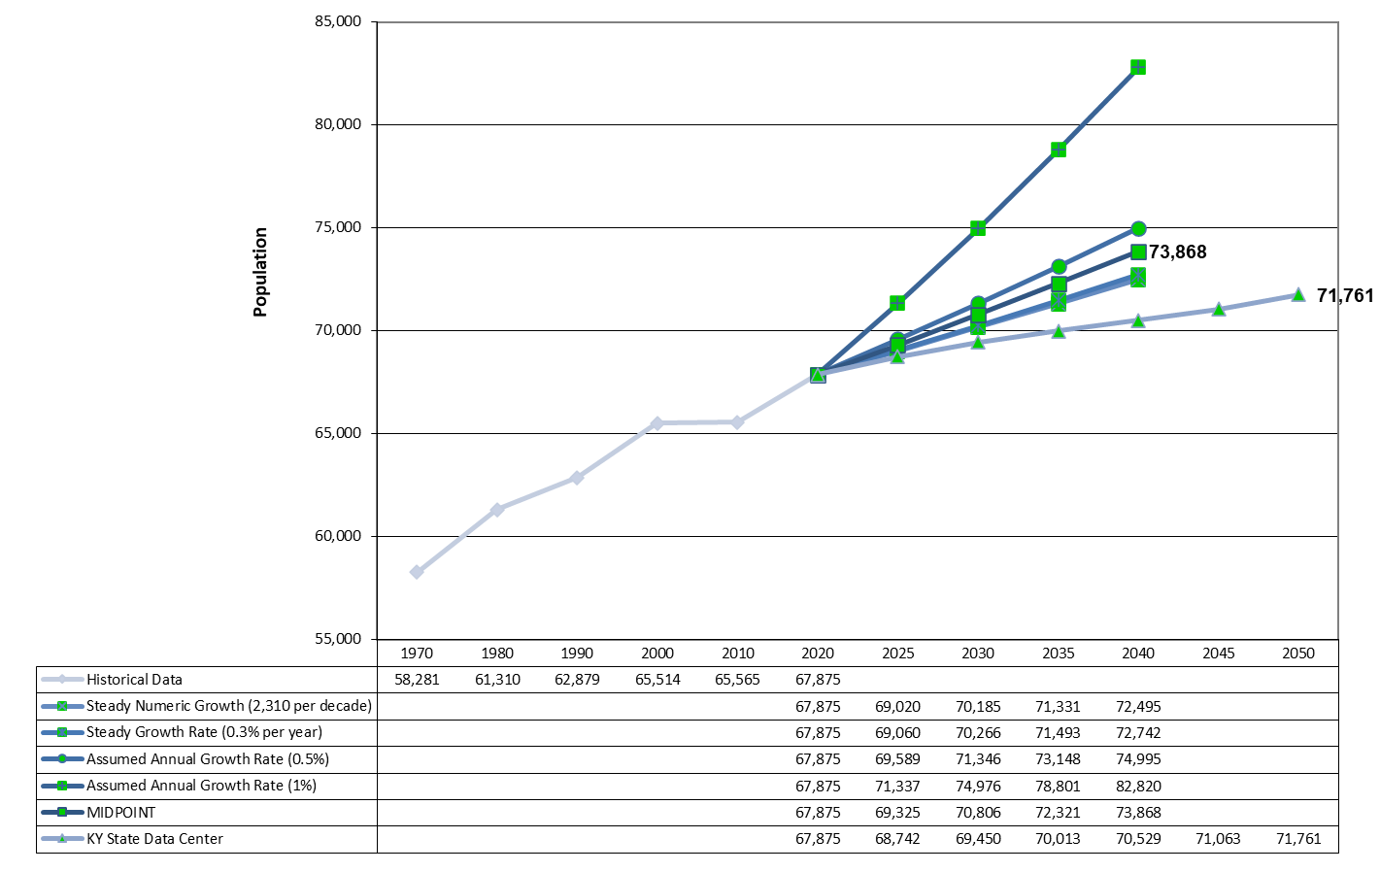
8.8% by 2040 vs 3.9%
Midpoint projection of 73,868 county residents by 2040

Slide 7
8.8% by 2040 vs 3.9%
28,198
City projection of 29,547 by 2040 if still 40% of County total

Slide 8
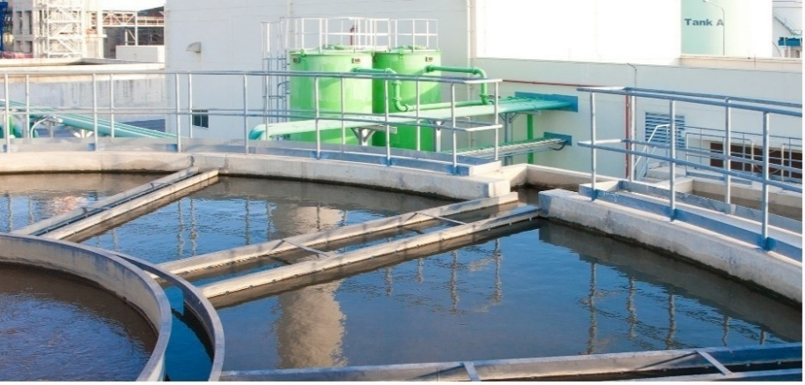
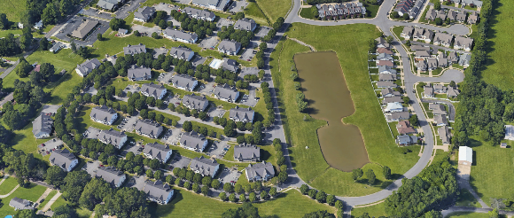
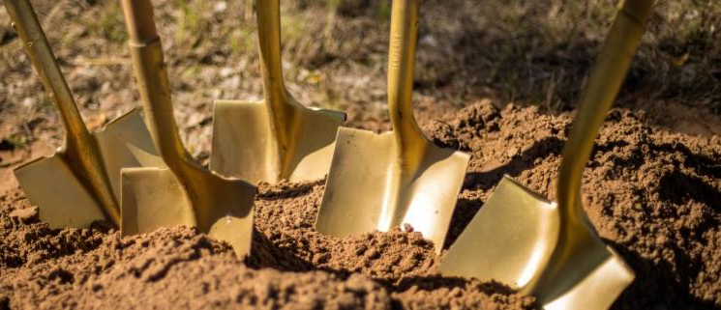
6 Comprehensive Plan Topic Sections
Growth Capacity
Transportation
Economic Development
Land Use & Community Character
Housing & Neighborhoods
Recreation & Amenities

Slide 9
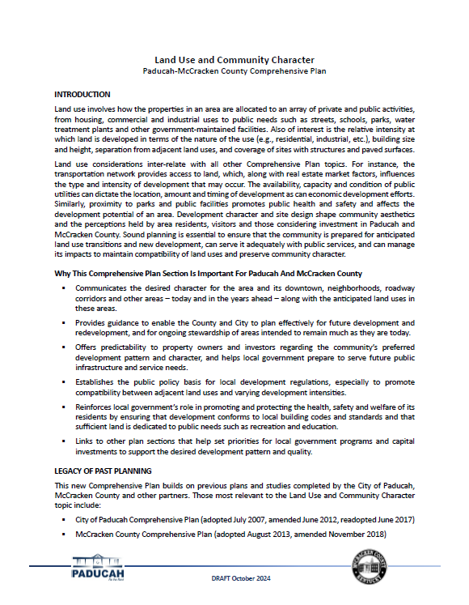
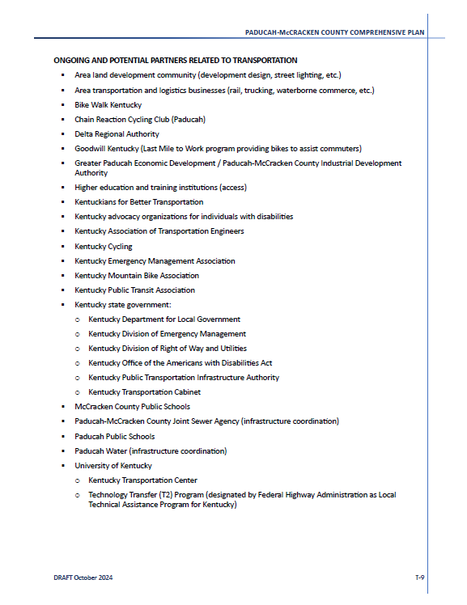
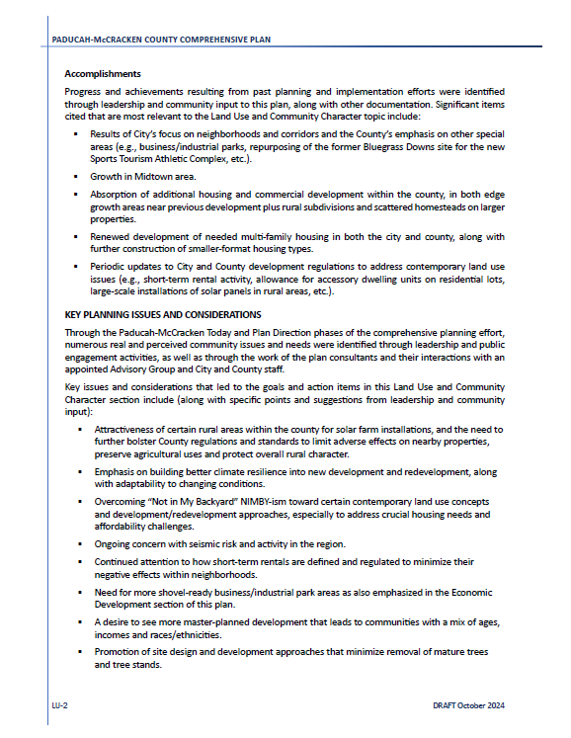
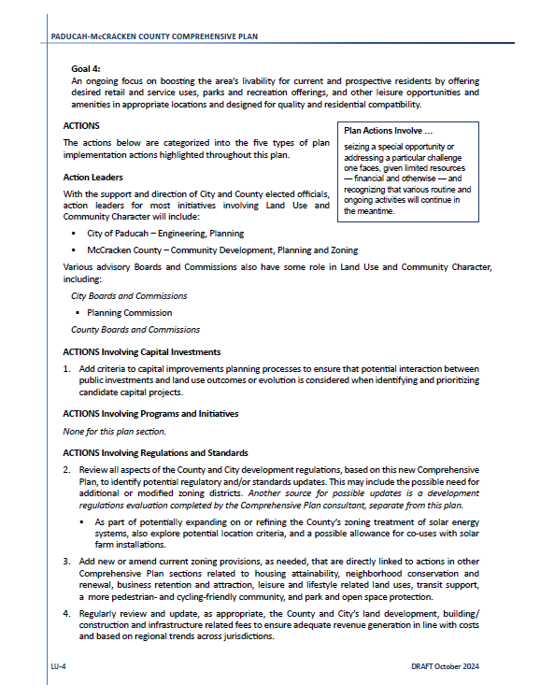
Why Important
Legacy Issues
Accomplishments
Partners
Plan Structure
Action Leaders

Slide 10
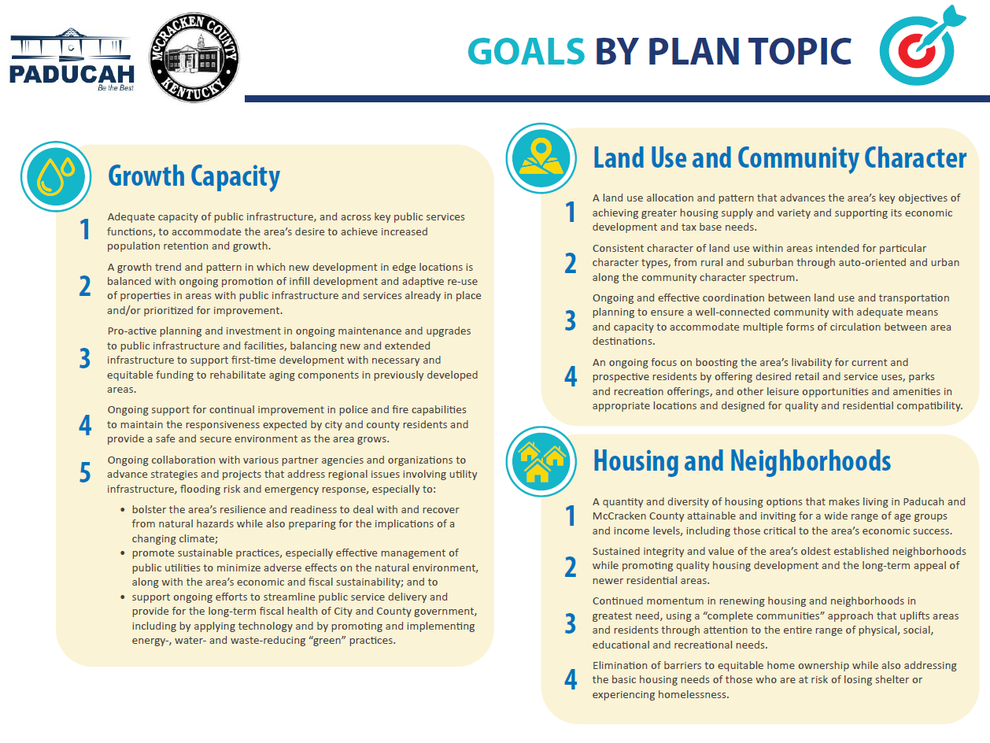

Slide 11
Key Words from Plan Goals
Growth Capacity
Transportation
Adequate capacity
Edge + infill
Extension + rehabilitation
Police/fire support
Regional partnerships
Connectivity and options
More – and safer – biking and walking
Economic development support
Systematic street maintenance method
Economic Development
Land Use & Community Character
Housing + economic development
Consistent character
Land use/transportation coordination
Livability elements
Resilient, diverse, stable economy
Holistic approach (quality of place)
Community assets to support E.D.
Hub community
Fresh and identity and image (growing)
Housing & Neighborhoods
Recreation & Amenities
Quantity and diversity
Sustained integrity
Renewed housing and neighborhoods
Removal of homeownership barriers
Vibrant hub of western Kentucky
Park reinvestment + more connected
Convenient, equitable park access
Economic, social power of arts/culture
Physical and culture heritage
Landscapes and natural resources

Slide 12
Produce a joint City/County map, still with separate categories tied to the respective zoning districts of City and County
Reflect actual development outcomes since previous map updates
Provide for further residential and commercial development – within reasonable reach of public infrastructure
Accommodate economic development needs and priorities
Maintain rural character in sparsely developed portions of county
Objectives for Future Land Use Map Update

Slide 13
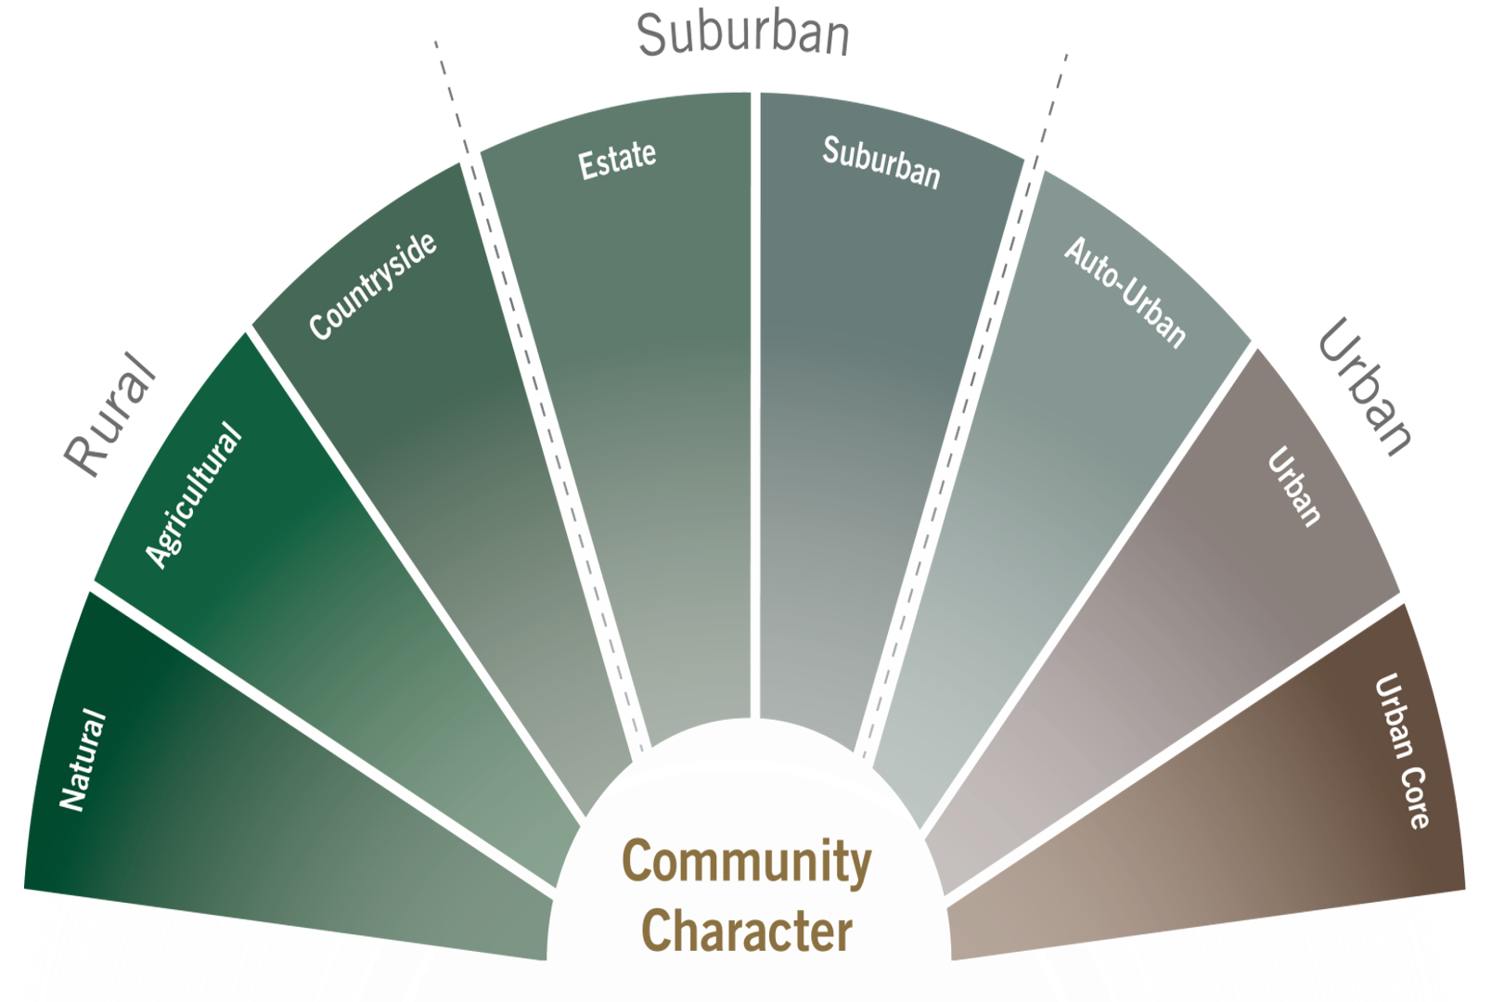

Slide 14
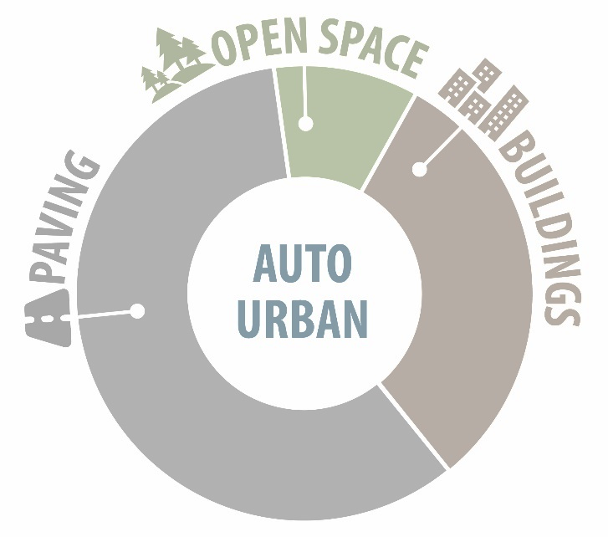
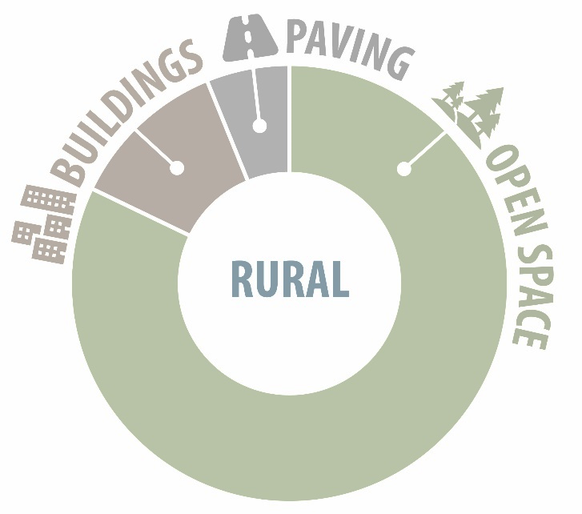
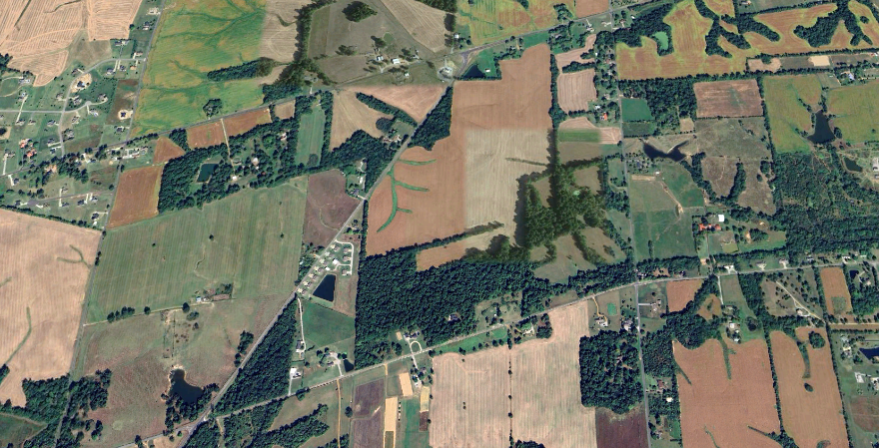
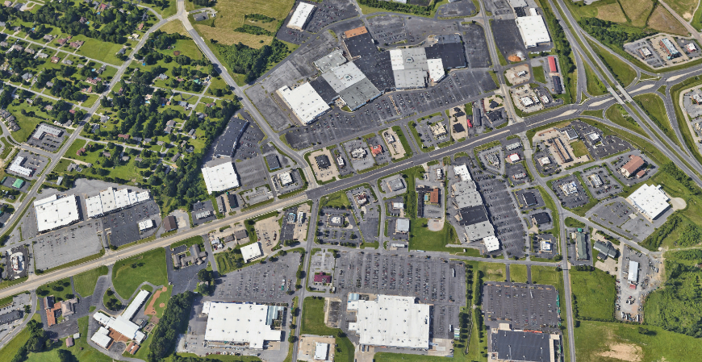
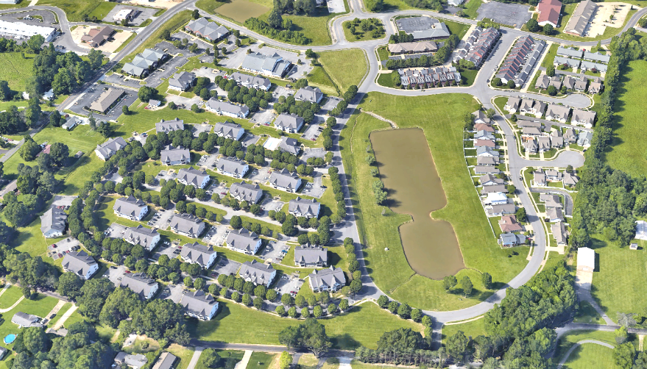
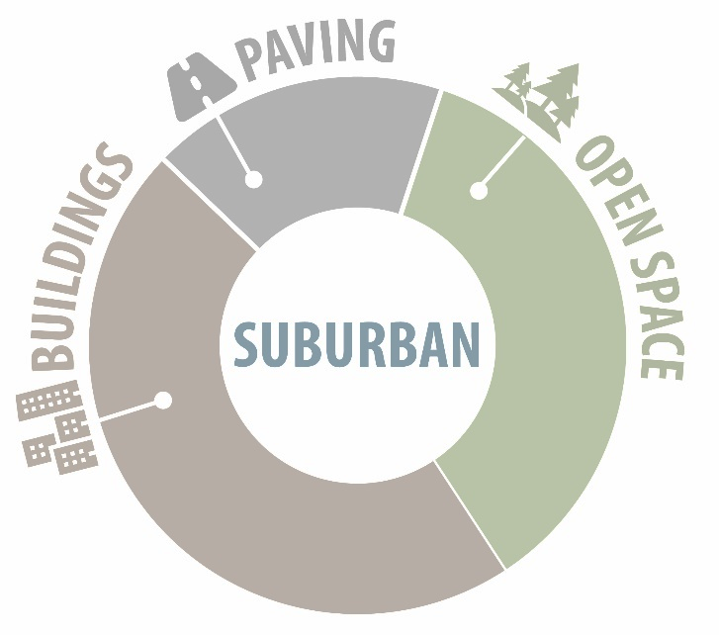
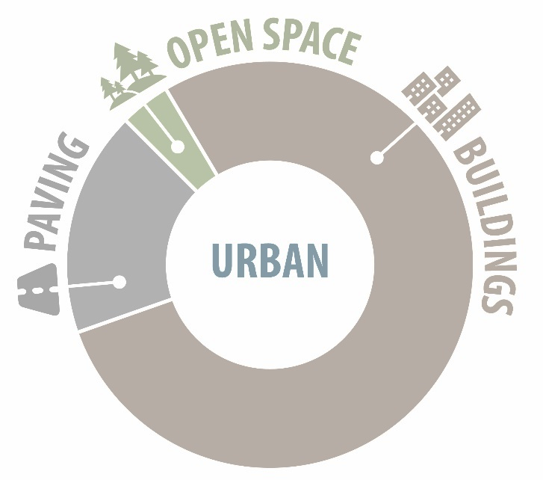
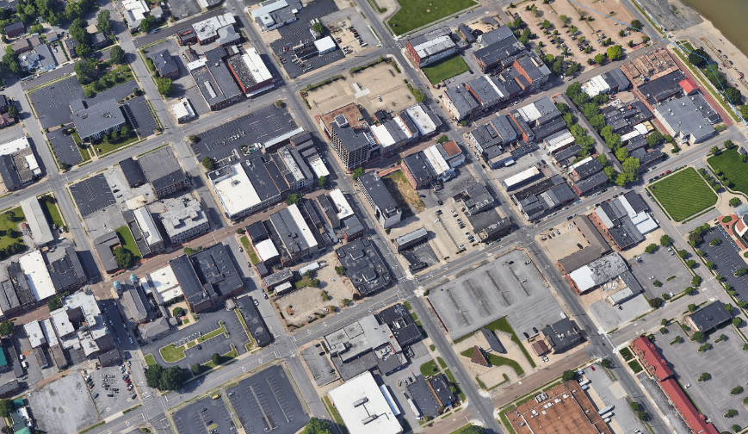

Slide 15
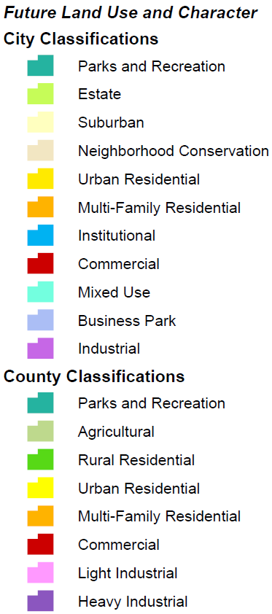
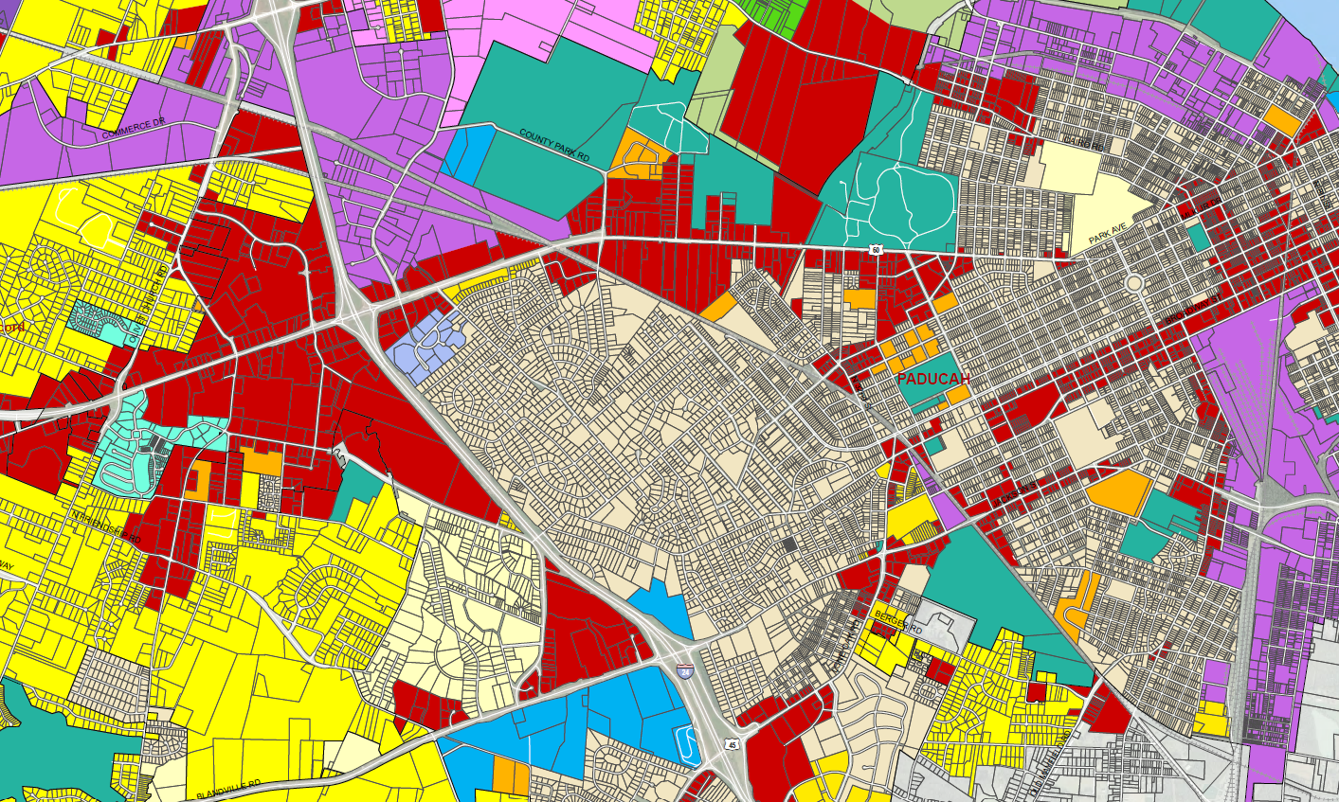
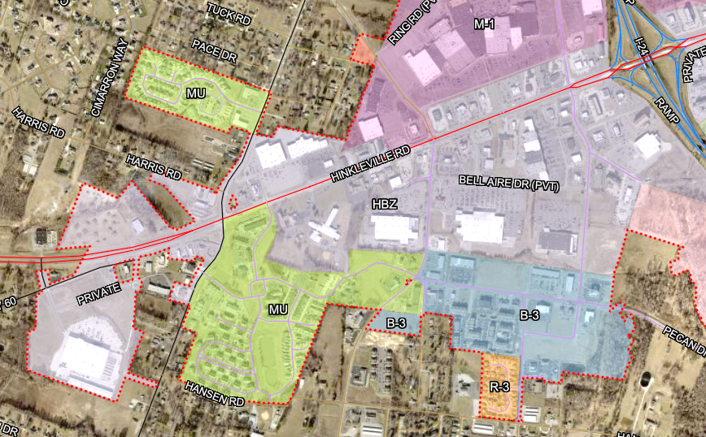
Draft New Future Land Use Map
City Zoning

Slide 16
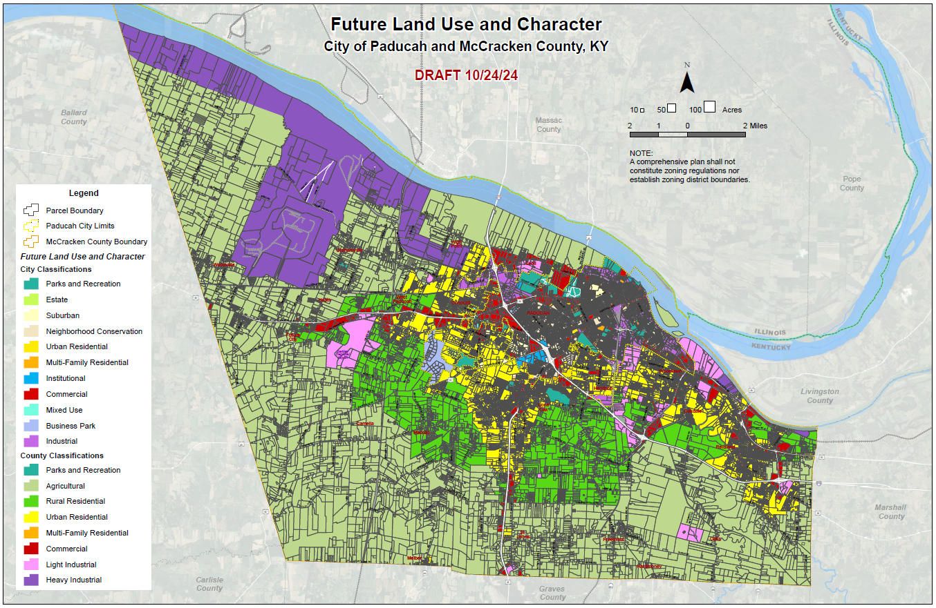

Slide 17
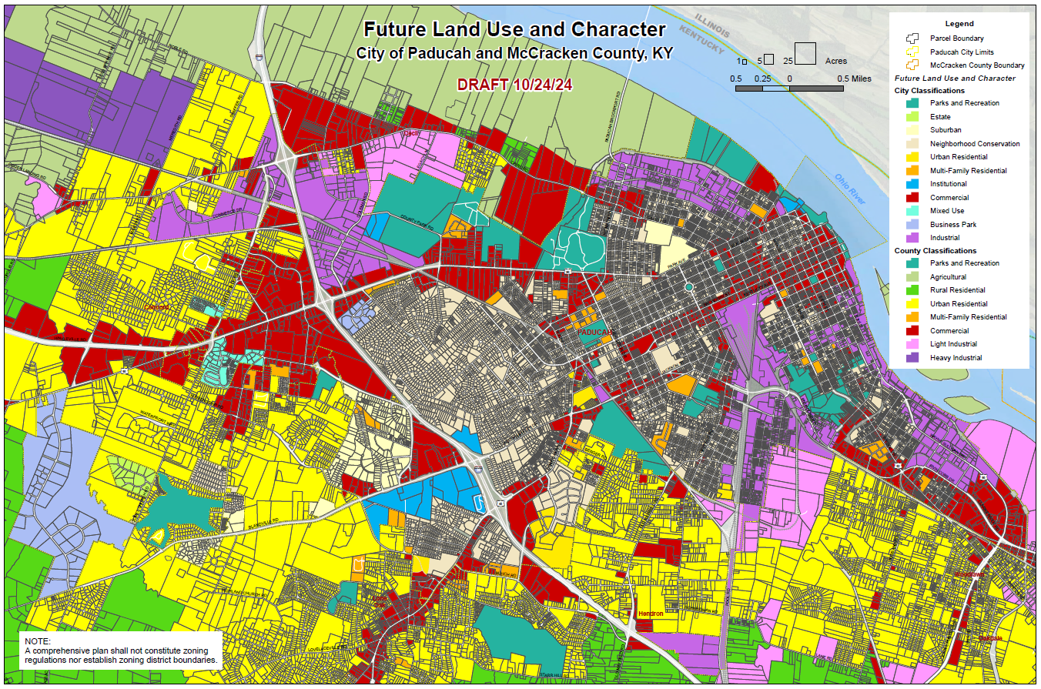

Slide 18
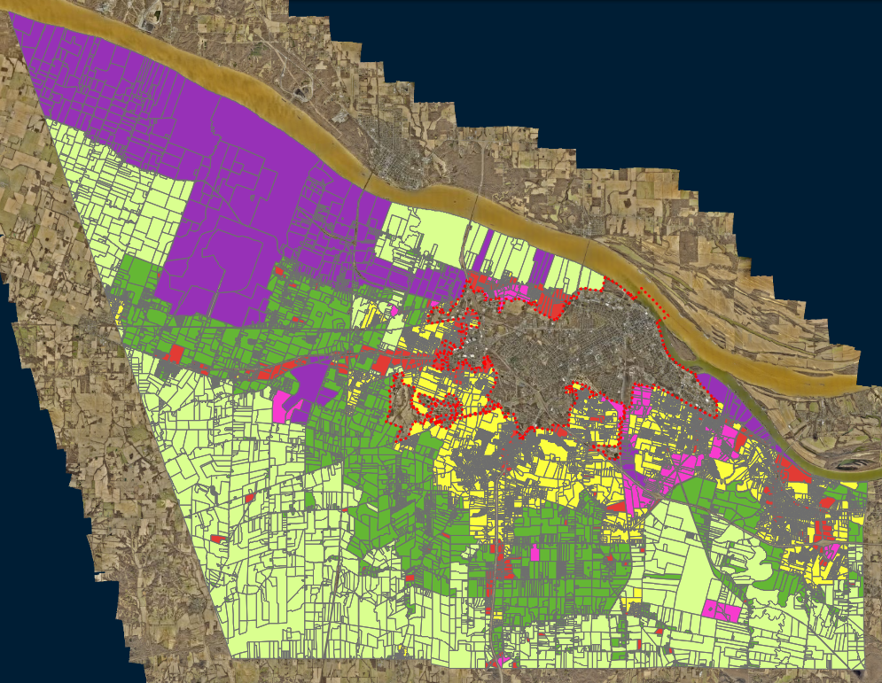
Current County Map
Potential New Map
Reduced extent of Heavy Industrial in county, especially northwest
Reduced extent of Rural Residential, especially scattered amid largely Agricultural areas
Reduced extent of Urban Residential in county to south, centered around Lone Oak area
Minimized Commercial amid Agricultural, mainly at established intersection locations
Mostly fine-tuned inside of city edges, plus categorizing areas annexed in recent years

Slide 19
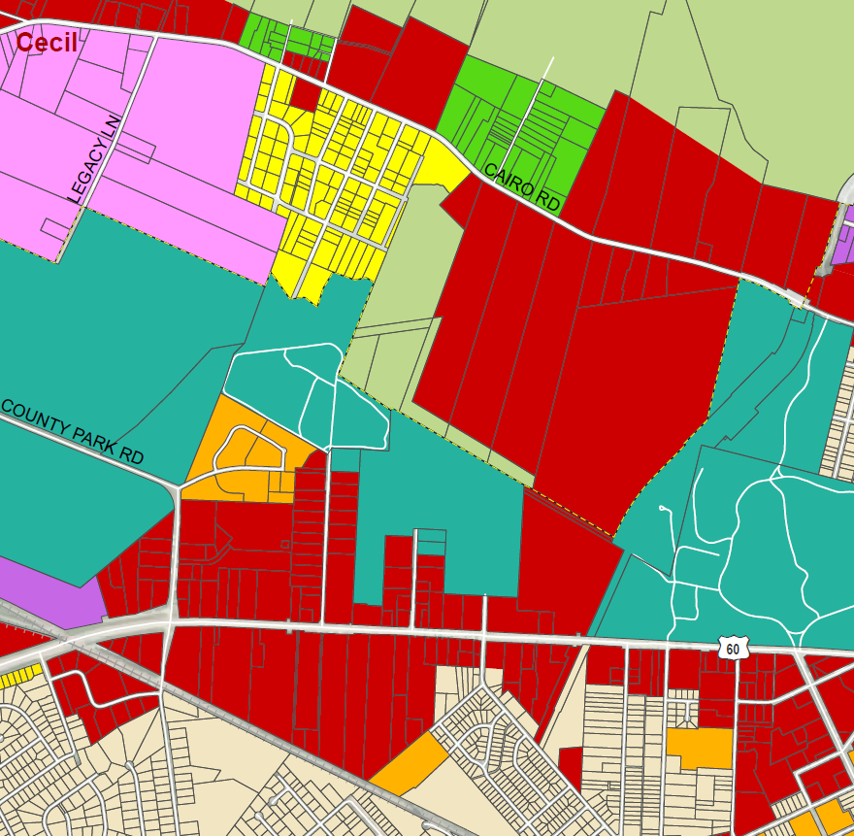
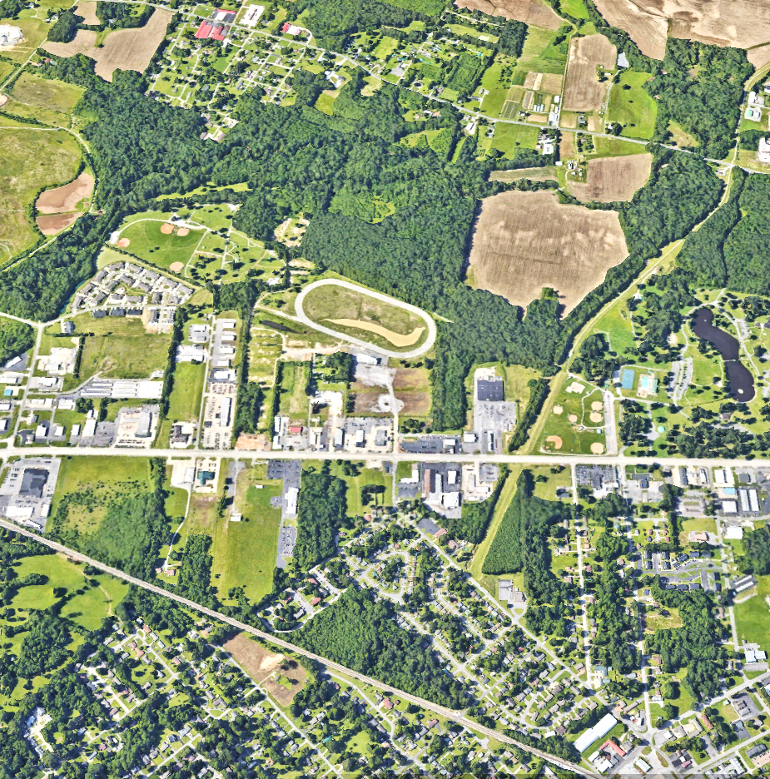
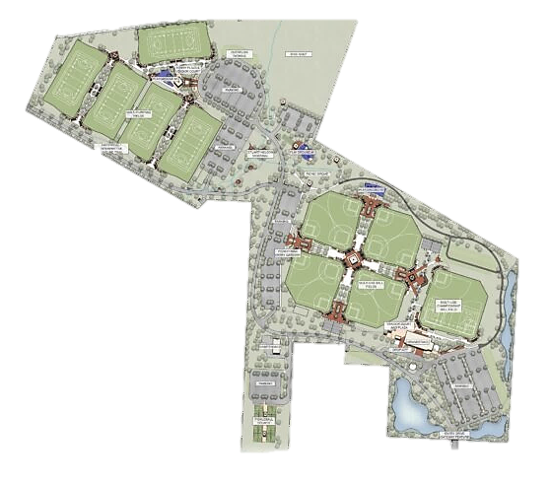

Slide 20
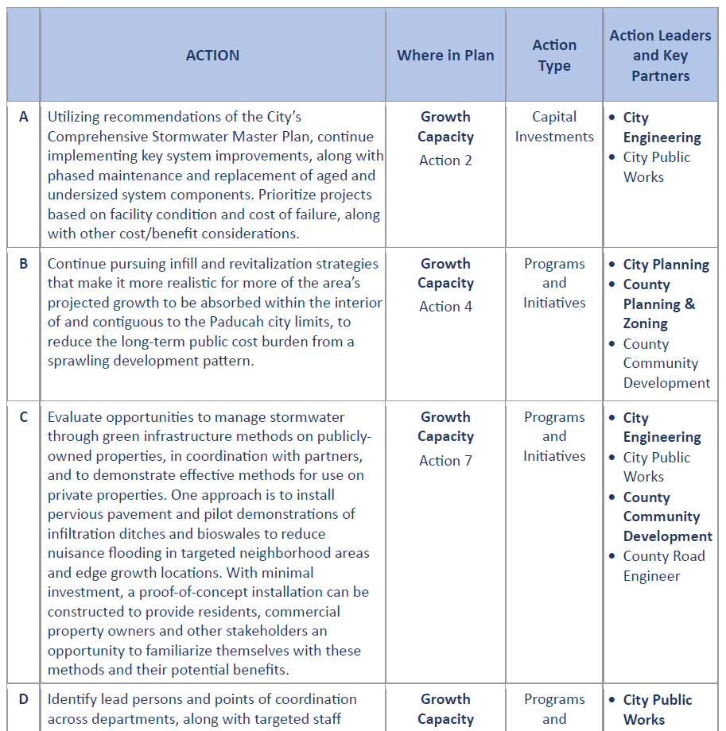
New Action Agenda
to feed into annual budgeting, capital improvements planning, department work planning, new/ongoing partnerships, grant pursuits
Areas of action likely to receive the most attention and resources in the years ahead (20 of ~120)

Slide 21
Community and Leadership Engagement
CONCERNS from Public Review:
On-street bike lanes
Preservation of trees and green spaces
More attention to homeless and realistic low-income housing
More focus on collaboration
More focus on sustainable development (denser housing, multi-use areas, alternative transportation, etc.)
More focus on affordable living
Increased bikeability
Increased access to local events
Cost to develop cottage housing

Slide 22
Community and Leadership Engagement
CONCERNS from Public Review:
Rooftop versus solar farms
Maintain river views (bldg height)
Use waterfront for entertainment
Enough convenience stores!
More activities for seniors
Infill before edge development or annexation (to grow)
Nonconforming buildings (effect on neighborhoods, corridors)
Good-paying jobs to support arts
Mall/commercial vacancy and business types - Good quality grocery store
Preserve Paducah history, assets

